Slide 1
Defence Travel System E-Ticketing
Air Travel oriented Presentation

Slide 2
Scope of the Presentation
Introduction
Background
System overview
Advantages of the System
Rail Travel flow
Air Travel flow
Advantages Air Travel

Slide 3
GOI Sanction - June 8th 2009 Project divided into 4 phases
Phase-I | Implementation of e-ticketing platform for three Services for Rail Travel in lieu of railway warrants
Phase-II | Extending the system to air travel
Phase-III | Extending the system to Defence Civilians
Phase-IV | On line submission of TA/DA claims

Slide 4
System Overview
Units/formations will book e-tickets for Rail Travel and Air Travel through PCDA(Travel) web portal.
Login Id, password, security questions and digital certificates for each user will be provided to these Units by DTS.
Cashless system. Any financial transaction through Pay Account office only. Amount to be debited/credited in the IRLA/Pay Account.

Slide 5
System Overview
Data once created will be used for entite service
Data Creation and Edit facility with unit only
Data can be upgraded on real time
Authorisation, entitlement checks and Accounting System
Two tier of approvals being financial transaction

Slide 6
System Overview
Tickets can be booked for any user by any of the units – No dependency of location

Slide 7
Exceptions
Following movements will be out of the ambit of the proposed system
Form C (IAFA-1707A-for Military special trains, vehicles, wagons and compartment)
Military credit Notes for Military Stores. (IAFA- 1711 )
Any personal movement not covered under Govt. rules

Slide 8
Advantages of the System
Facility for getting e-tickets at the units itself throughout the country anytime without extra load on units.
Manpower saving at unit level – NO TA DA advance
Nil cash handling, less paper movement.
No dilution in the role of the controlling officer.
Facility to know the entitlements.

Slide 9
Advantages Contd
No dilution in the role of the controlling officer.
No change in existing computerised system of Railways.
Facility to know the entitlements. Units expenditure available at hand – budget control
MIS that help in administrative matters also
Issue of lowest fare resolved
Issue of outstanding demands resolved
Reconciliation of accounts daily

Slide 10
Security Features
https protocol followed for transmission
User name, Password policy (As followed in Net banking)
Validity for 15 days
Token based Digital signature
Role based access control. (E.g. Portal, Admin links are different)
Second factor authentication with security questions
User Audit log (with IP address, time and date stamp)
Automatic or Scheduled back up
Exchange with Balmer & Lawrie and IRCTC through SSL
10

Slide 11
DTS Air Modules
Temporary Duty (TD) One Way Bookings & Cancellations.
Temporary Duty (TD) Normal Round Trip Bookings & Cancellations.
Temporary Duty (TD) Special Round Trip Bookings & Cancellations.
Permanent Transfer(PT) One Way Bookings & Cancellations.
Mid Office MIS ( Invoices, Credit Notes, Refunds) Integration into DTS.
DTS & Mid Office MIS Reconciliation.

Slide 12
Air Booking Module Salient Features
TD/PT Air Booking Request Creation
Request Can be One Way or Normal Round Trip or Special Round Trip.
AI Normal Request to be created for AI Operational & Availability Days.
Special Request can be created for AI non availability days and requires DGCA approval during booking.
Blanket Approval on AI Non-Operational sectors allows Other Airlines request creation and bookings.
Auto Invoice generation during ticketing.

Slide 13
User Profile Creation Page

Slide 14
User Profile Creation Page Continued

Slide 15
DTS AIR Booking Process Flow (Mixed Mode Not in Scope)

Slide 16
Air Cancellation Salient Features
TD/PT Air Bookings Cancellations.
Cancellations can be passenger wise or onward/return/both way.
Auto Credit Note generation during cancellation.
Refunds gets adjusted in the next billing cycle.

Slide 17
DTS AIR Cancellation Process Flow

Slide 18
Air Booking Process

Slide 19
Master Booker (MB) Enters Security Answer

Slide 20
MB clicks on Travel Request

Slide 21
MB Selects Air and Fills Form

Slide 22
MB search & selects AI flights

Slide 23
MB saves the Request

Slide 24
Commanding Officer(CO) Logs into DTS

Slide 25
CO Enters Security Answer

Slide 26
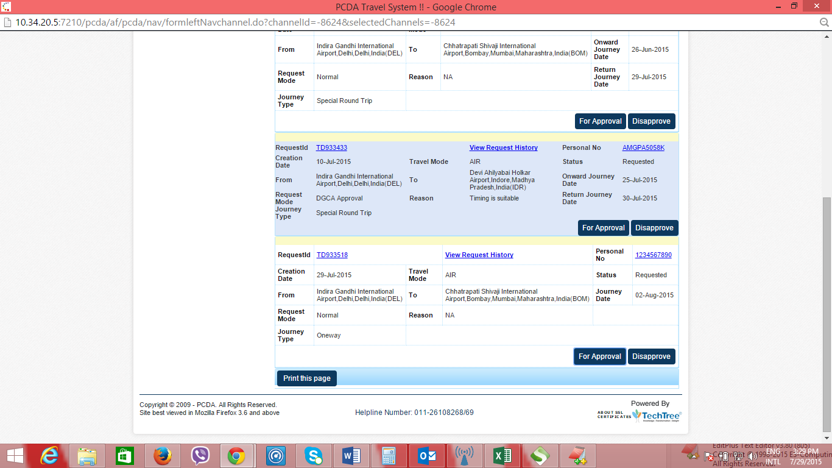
CO approves the Request Id

Slide 27
MB clicks on Book Air on Request Id

Slide 28
MB selects Air India Flights and clicks Book

Slide 29
MB can edit Passenger contact details

Slide 30
MB views & prints Air Ticket

Slide 31
Air Cancellation Process

Slide 32
MB selects Booking Id for cancellation

Slide 33
MB Sends Cancellation request to CO

Slide 34
CO Approves Cancellation Request

Slide 35
MB Proceeds For Cancellation

Slide 36
Cancellation Requested Accepted At Mid Office

Slide 37
Air Travel Advantages
Traveler need not to visit Balmer Lawrie Booking Counters/helpdesk, or any other booking portals
Auto Debit from IRLA/Pay Account as per the rules.
No hidden fares and comprehensive list of cheapest fares available.
Other Airlines Booking Option for Air India Non Operational sectors provided by DGCA.
Auto Invoice , Credit Notes generation during bookings and cancellations.
MIS(Daily Sales & Refunds) Uploads from Mid Office into DTS for reconciliation.
Trigger based reconciliation b/w Mid Office MIS and DTS data.

Slide 38
THANK YOU

